Slide 1


Disaster Strikes and Florida Responds: Takeaways from the 2022-23 Hurricane Seasons and Rescue Operations
PRESENTED BY: Karen Hagan, APD Emergency Coordination Officer
Michael Taylor, APD Suncoast Regional Operations Manager
Kristin Korinko PhD, APD Sr. Behavior Analyst
Shannon Hagan, Florida Division of Emergency Management Deputy I.A. Officer
David Brown and Anjali Van Drie, President and Vice President, Family Initiative
Ron DeSantis, Governor
Taylor Hatch, Director

Slide 2
Atlantic Hurricane Season
June 1 – November 30
  The 2023 Atlantic Hurricane Season
  21 storms – 20 named and a rare unnamed January cyclone
  7 Hurricanes, 3 became major hurricanes
  Hurricane Idalia –the only landfalling major Hurricane
    Made landfall in Florida near Keaton Beach on August 30, 2023
    Category 3 Hurricane with 125 mph sustained winds and 7-12 feet of storm surge
    Across Levy, Taylor, and Dixie counties’ coastal communities
  2023 was the fourth most active season since 1950
Lesson Learned: It Only Takes 1!

Slide 3
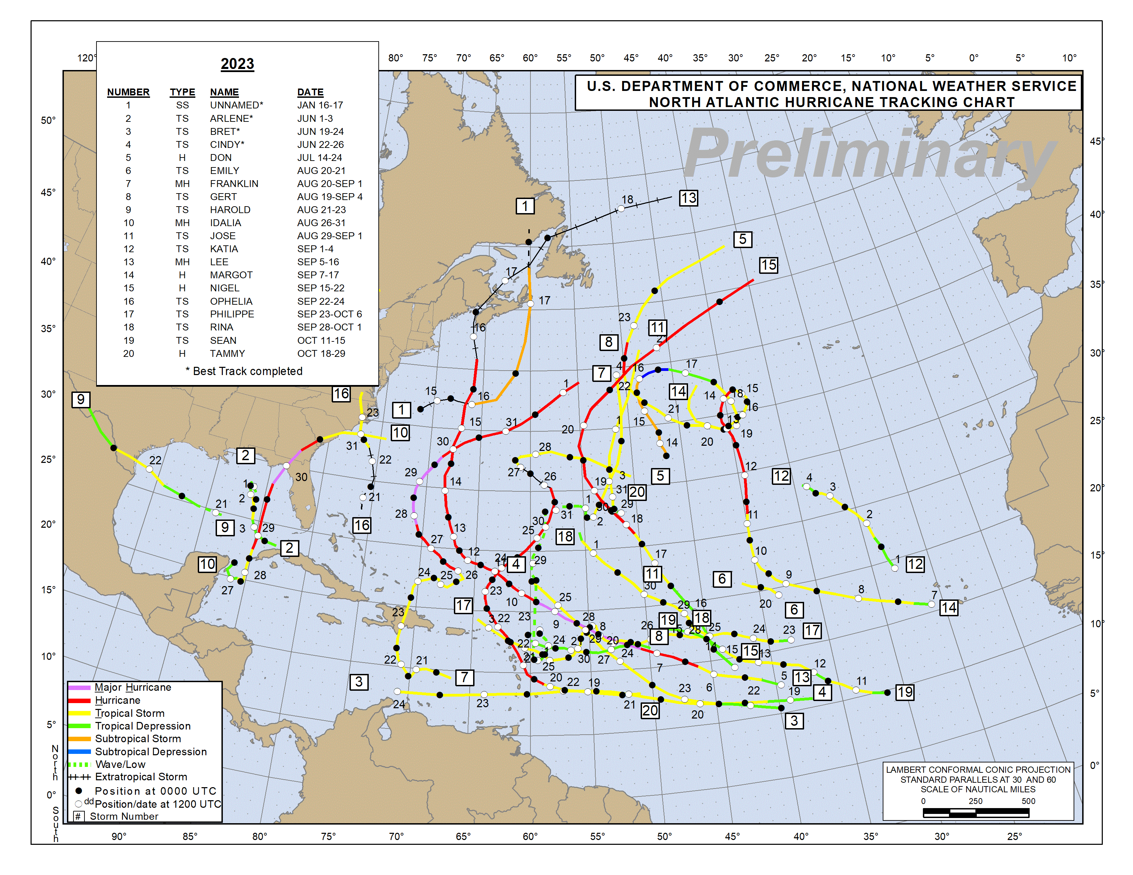

Slide 4
Sheltering and Feeding Data
Hurricane Ian
At peak, 256 total general population shelters opened with 70,390 individuals reported as sheltered
63 Special Needs Shelters opened across the state with 4,209 individuals sheltered, 1,744 staff, and 48 service animals (dogs)
Food and water: Distribution of over 4 million hot meals, over 15 million Meals Ready to Eat (MREs), over 500,000 food boxes, and over 2 million cleanup/hygiene kits

Slide 5
Sheltering and Feeding Data
Hurricane Idalia
At peak, 111 total general population shelters statewide opened with 4,889 individuals reported as sheltered
  44 Households (124 Individuals) in trailers on private property (generally their pre-disaster address)
  18 Households (38 Individuals) in trailers at Commercial Parks
  28 Households (71 Individuals) in Hotels
45 Special Needs Shelters opened in 38 counties with 598 individuals sheltered, 1,137 staff, and 166 caregivers
Food and water: Served 561,544 meals, delivered over 730,000 meals, over 277,000 food boxes, and nearly 1 million bottles of water
Lesson Learned: If you’ve seen one disaster you’ve seen one disaster!

Slide 6
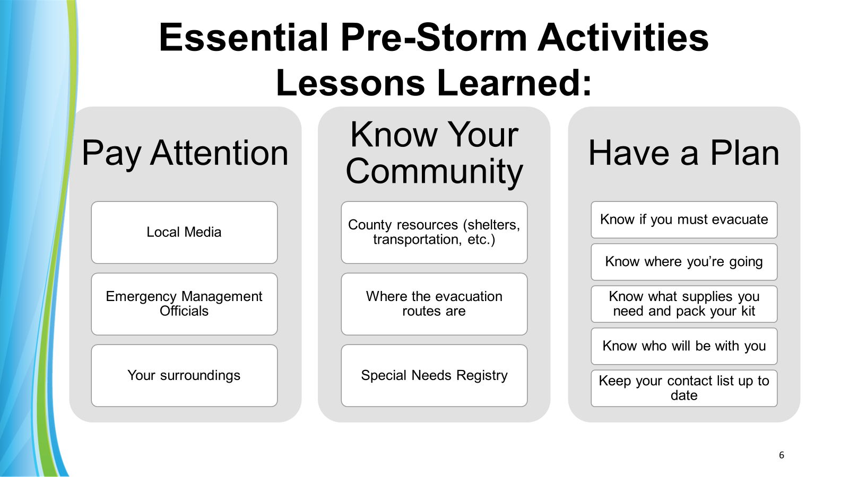

Slide 7
Post-Storm Activities
Recovery Lessons Learned
  Situational Awareness is Key (Local, State, & Federal)
  Increase efforts of door-to-door contact to reach those isolated, homebound, or with other access and functional needs
  Accessible transportation to feeding sites and Disaster Recovery Centers (DRCs) is vital
  Awareness of and access to available services and resources as they come online
  Ongoing communication to identify unmet needs
  Monitoring displaced persons and providers
  Presence in Disaster Recovery Centers (HHS Agencies)

Slide 8

APD Information and Reporting Structure
Living Settings
  Family Home
  Independent Living
  Supported Living
  Residential Habilitation
Reporters
  Families/Individuals
  Support Coordinators
  Supported Living Coaches
  Group Home Managers

Slide 9
Keeping People Safe…
APD’s Situation Report

Slide 10
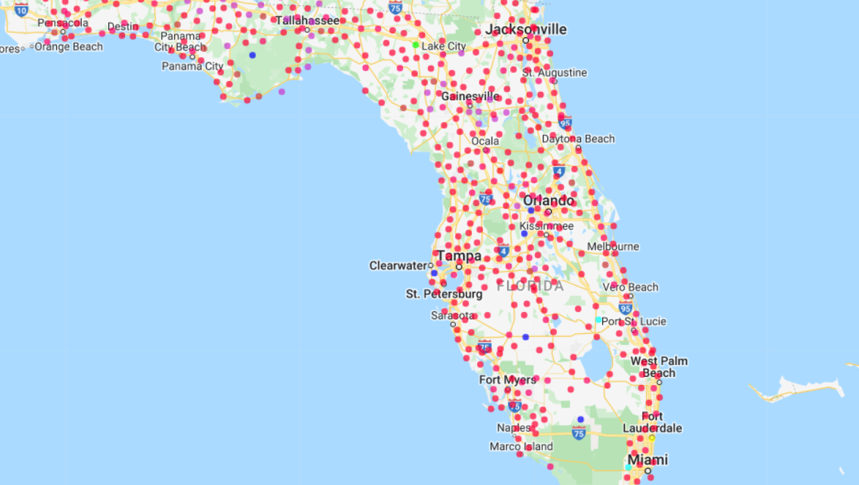
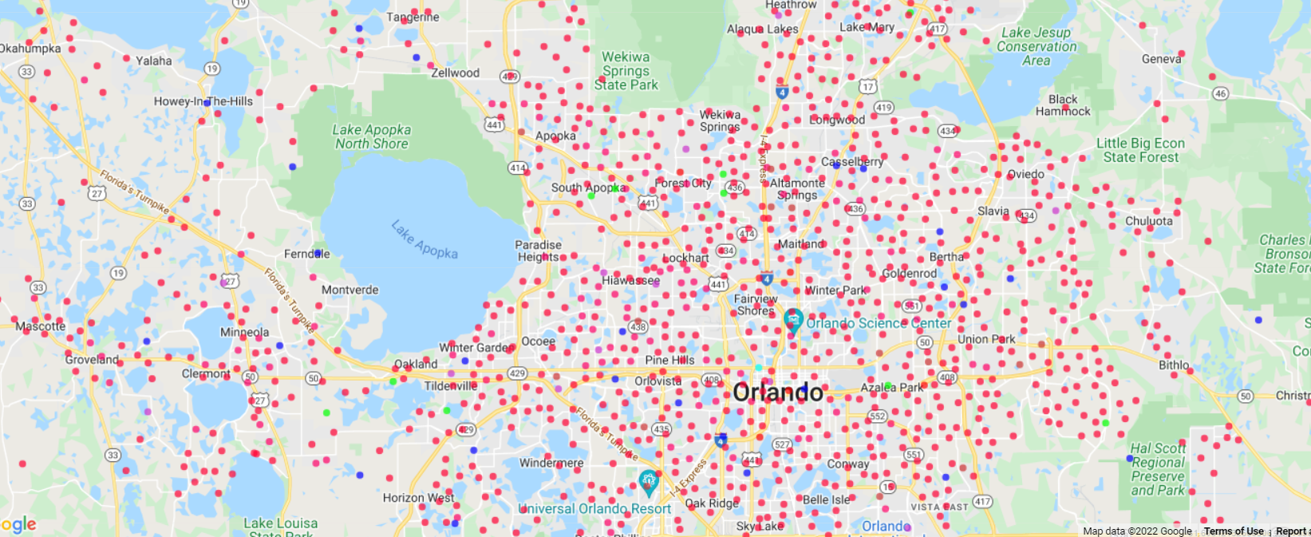
Everbridge and APD GIS Mapping

Slide 11
State Emergency Response Team (SERT)
The State Emergency Response Team (SERT) is tasked with providing disaster assistance to the residents of the state of Florida.
The SERT is comprised of branches and Emergency Support Functions (ESFs). These entities work closely with one another to fulfill mission tasks and requests for direct aid to disaster impact areas.
APD is part of ESF #6 Mass Care and ESF #8 Health and Medical Services.
The Florida Division of Emergency Management partners closely with FEMA before, during, and after disasters.

Slide 12
Ongoing Long-Term Recovery
FEMA Direct Temporary Housing
Time-limited housing assistance in Manufactured Housing Units (MHUs) and travel trailers
State Non-Congregate Sheltering (NCS)
State-led temporary sheltering in travel trailers and hotel rooms
Disaster Case Management Program (DCMP)
Assists disaster survivors to develop and navigate individual recovery plans
Long-Term Recovery Groups (LTRGs)

Slide 13
Best Practices and
Lessons Learned
Navigating FEMA Individual Assistance (IA)
  Visit a Disaster Recovery Center (DRC)
  Understand what resources are available
  Update your application if your situation changes
  Understand the relocation question
  Keep receipts for expenses purchased with FEMA funds
  Don’t be afraid to appeal FEMA’s determination!
The importance of maintaining home insurance, flood insurance, and renter’s insurance if applicable
The importance of heeding local officials’ warnings and evacuation orders

Slide 14
Disaster Mental Health
More than 40 million adults in the U.S. suffer from a mental illness.
Victims of natural disasters are at an increased risk of anxiety, depression, PTSD, and suicide.
25-50% of people exposed to an extreme weather disaster are at risk of adverse mental health effects.
Up to 54% of adults and 45% of children suffer depression after a natural disaster.
49% of the survivors of Hurricane Katrina developed an anxiety or mood disorder, and 1 in 6 developed PTSD. Suicide and suicidal ideation more than doubled.
Anniversaries of disasters may trigger an uptick in mental health crises for survivors.

Slide 15
How to Cope When Life Seems Overwhelming
Distract yourself - take an hour or two away from your problems. If you weren’t worried about your problems, what would you be thinking about?
Routine - if you can’t do, do what you can!
Exercise
Change your physical location - stretch, go outside if you can, get some sun.
BREATHE (Insight Timer, Calm, Headspace)

Slide 16
How to Cope When Life Seems Overwhelming
Pray or meditate
Practice mindfulness
Start a journal
Organize – a closet, papers
Write a letter to a friend
Talk to others – you may find that helping them makes you feel better!

Slide 17
Humanitarian Missions:
Rescue Flights – Israel and Haiti
Florida Division of Emergency Management set up Multi Agency Resource Centers (MARCs)
Tampa Airport for flights coming in from Israel
Florida State Emergency Response Team (SERT), supported 4 flights and 700 Americans coming to Tampa from Israel.
Two cargo planes with 85 pallets of donated supplies arrived in Tel-Aviv from Florida.
Set up at the Sanford Airport then moved to the Orlando Airport for flights coming in from Haiti.
HAITI
Evacuees had access to resources including food, water, medical treatment, and transportation home.
ISRAEL
SERT, private, and non-profit partners successfully rescued 722 Americans

Slide 18
Key Partnerships
Agency for Persons with Disabilities
Provided on-site support at the MARC to welcome and act as a sought-after resource, offering immediate and long-term navigation and services for arriving Floridians with unique abilities.
Family Initiative
Prepared and supplied sensory kits to meet the needs of Floridians arriving home at the MARC.
Centers for Independent Living
Provided needed durable medical equipment to arriving Floridians with unique abilities.

Slide 19
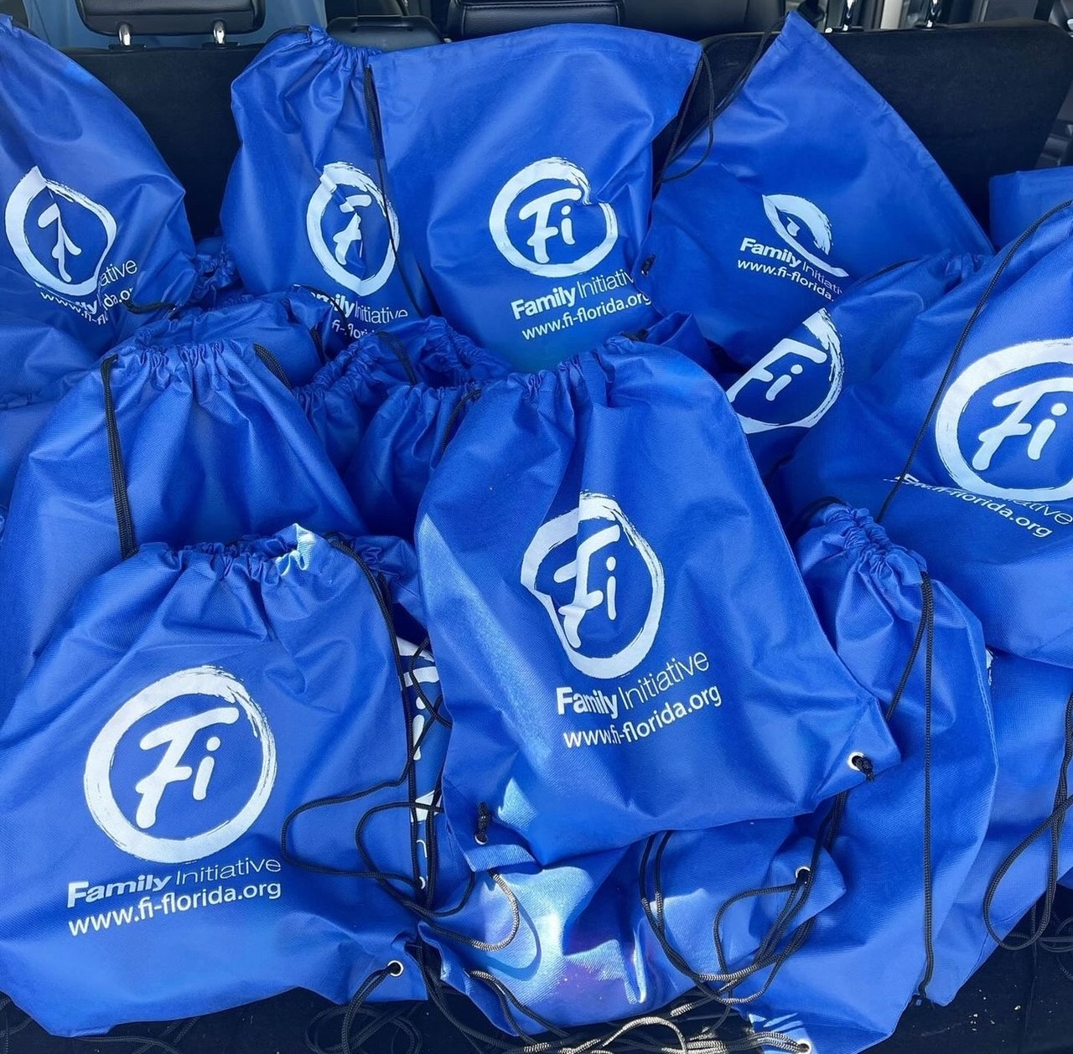
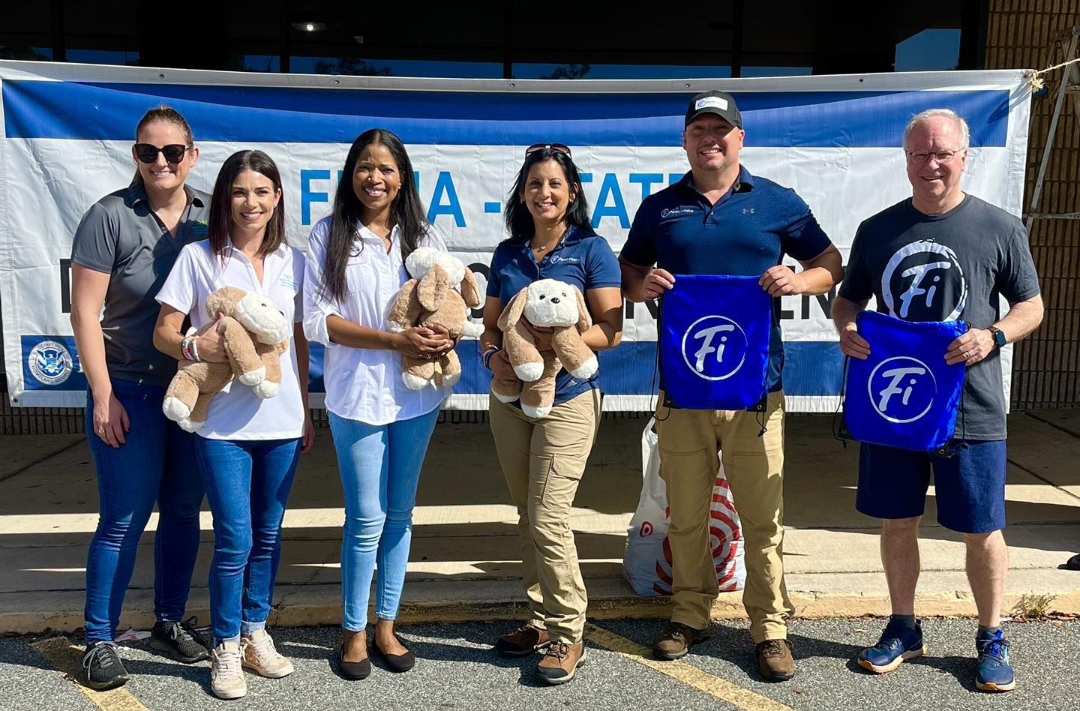

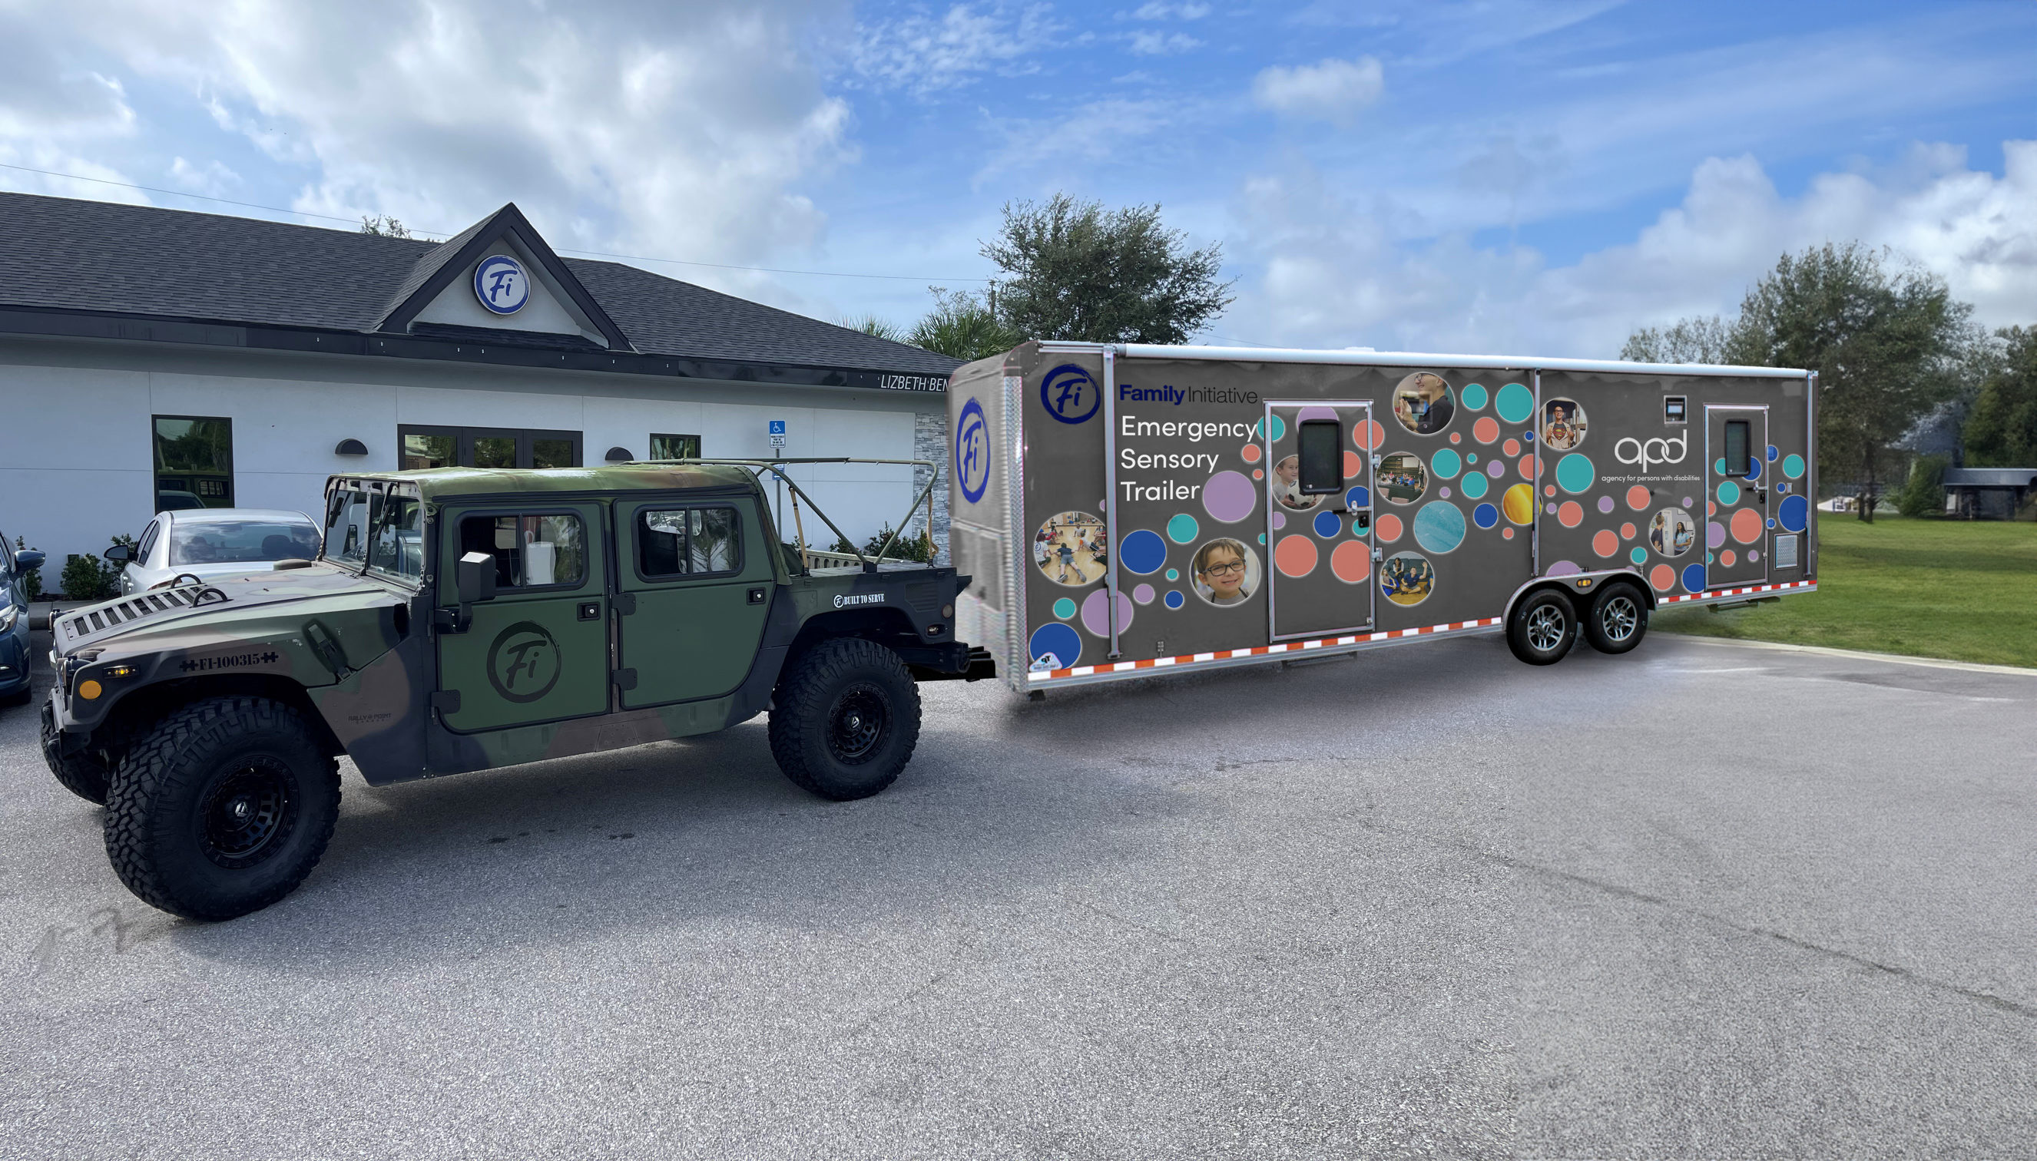

Family Initiative
Recovery Shelter – Hurricane Ian
Sensory Kits
Mobile Sensory Rooms
Hurricane Survey

Slide 20
Family Initiative
Lessons learned from preliminary data from our Hurricane Survey

Slide 21

Thank you!

Slide 22
Contact Us:
Karen Hagan 850-545-7725 Kristin Korinko 850-414-8695
Karen.Hagan@apdcares.org Kristin.Korinko@apdcares.org
Michael Taylor 813-233-4311 Shannon Hagan 850-815-5769
Michael.Taylor@apdcares.org Shannon.Hagan@em.myflorida.com
David Brown 239-691-4517 Anjali Van Drie 239-645-0458
dbrown@fi-florida.org avandrie@fi-florida.org

